Slide 1


Slide 2

  A hyperlink (or link) is a word, group of words, or image that you can click on to jump to another document
Using the following anchor tags, you can reference other people's work, point to other pages you like,
<a href="URL">……</a>
  <a href=“http://www.yahoo.com”> get new email account </a>
By default, links will appear as follows in all browsers:
  •An unvisited link is underlined and blue
  •An visited link is underlined and purple
  •An active link is underlined and red

Slide 3

If you do not want visitors to leave your page when they click on one of your links to another site, add this attribute to your anchor tag target="_blank"
<a href=“http://www.yahoo.com” target="_blank" > get new email account </a>
Target= “_blank | _parent | _self | _top”

Slide 4
Value | Description
_blank | Opens the linked document in a new window or tab
_self | Opens the linked document in the same frame as it was clicked (this is default)
_parent | Opens the linked document in the parent frame
_top | Opens the linked document in the full body of the window

Slide 5

You can change the colors of linked information on your page by inserting (link="color“& alink="color" & vlink="color“) tags within your <body> tag.
If you do not want visited links to change color, simply attribute the same color to both alink and vlink.
  <body alink="green" vlink="green">

Slide 6

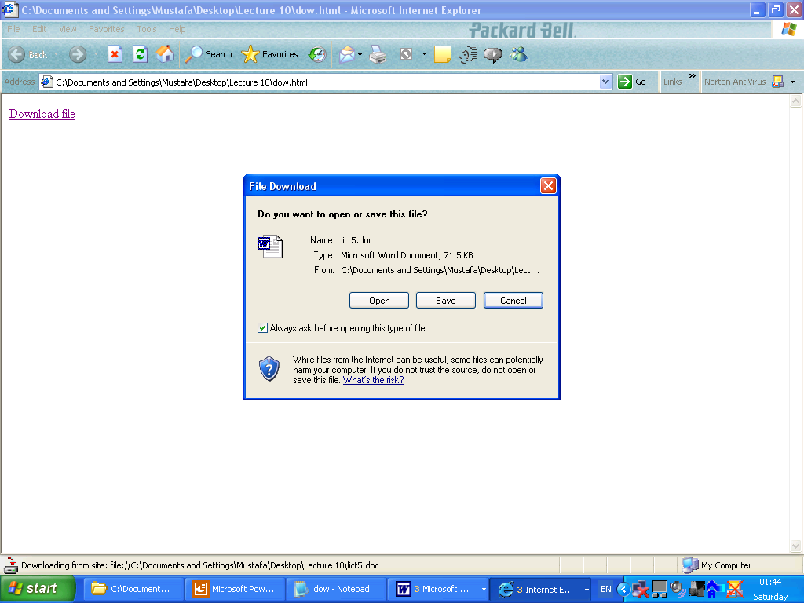
Example:
  <a href="Audioedit.doc"> Download file </a>

Slide 7

Example:
<a href="lict5.doc"> Download file </a>

Slide 8

If you would like to receive e-mail from people who read your page, use the following anchor tag.
  <a href="mailto:youremailaddress">Text</a>
  Ex :
  <a href="mailto:abcd@yahoo.con"> E-mail Me

Slide 9

Anchor tags are not only used for linking to pages on the Internet. You can also use them to link to information located within your own page.
You can just include the html document file name:
  <a href=“mypage.htm"> My first page</a>

Slide 10

To link to a specific postion of your page, you will need to name the section you are referring to, and include that name within the link's anchor tag.
  <a name/id="name">
You can choose any word, letter or character to use as a name:

Slide 11
In the anchor tag, you refer to this postion of your page by putting a "#" in front of the name.
<a href="filename.htm#5"> location within the page</a>
<a href="#top">
Note : &nbsp; is the entity used to represent a non-breaking space. It is essentially a standard space, the primary difference being that a browser should not break (or wrap) a line of text at the point that this &nbsp; occupies.

Slide 12

Place any digital image on your page using the following tag:
  <img src="name of picture file.extension“/>
Images on Web pages are either GIF files, JPG files or PNG file.
  JPEG : Joint Photographic Experts Group.
  GIF : Graphical Interchange Format.
  PNG : Portable Network Graphics.
  Images format

Slide 13

You can use an image as a link to another page or element.
  <a href="http://www.microsoft.com"> <img src="logo.jpg" ></a>
  <a href=“index.htm"> <img src=“computer.jpg" ></a>
Any digital image can also be used as a background for your page.
  <body background="background.gif">

Slide 14

“Alt”. It gives your image a label, appearing when the user passes the mouse over the graphic.
<img src="logo.jpg" alt=“click to download“ >
It also appears before the image appears as your page is loading in the browser

Slide 15

You can change the size of the image by adding width & height within image tag.
  <img src="computer.jpg" width=80 height=120 >
And you can change the border’ size of the image by adding the value of the border within image tag.
  <img src="computer.jpg" border=5 >

Slide 16

The horizontal alignment of images on your page is formatted using the tags described in the justification section.
  Use the <div align=.".."> tag before the image tag to center or justify right or left.
  Use the align attribute within the "img src" tag to have text around the image.

Slide 17
For the vertical & horizontal alignment of images insert these tags within the "img src“
  align="bottom“.
  align="top“.
  align="middle“.
  align=“left”.
  align=“right”.
For the space between the image and text. “vertical & horizontal”
  <img src="computer.jpg" align="left" hspace=20 vspace=20 >

Slide 18

When you have many images in your page and you want to load them as fast as possible. You can use “onclick & ondbclick” to change the size of the view.
<img src="computer.jpg" width=“80" height=“110" ondblclick="height=280; width=200" onclick="width=80; height=110">

Slide 19

Using <hr> tag you can draw line to divide your page. By using some attributes within it you can change the color, size, width and the place.
  Example
  <hr size=“200“ width="30" align="center" color ="blue" >

Slide 20
Playing audio in HTML is not easy!
You must know a lot of tricks to make sure your audio files will play in all browsers (Internet Explorer, Chrome, Firefox, Safari, Opera) and on all hardware (PC, Mac , iPad, iPhone).
Sounds can be played in HTML by many different methods.
  <bgsound src=“music.wma”>
There are some types of audio/vidio files can use on the web such as “.mp3, .wma, .wav, .mid”
Video types

Slide 21
Using A Hyperlink
If a web page includes a hyperlink to a media file, most browsers will use a "helper application" to play the file.
ex: the example displays a link to an MP3 file. If a user clicks on the link, the browser will launch a helper application to play the file:
< a href="horse.mp3">Play the sound</a>
Yahoo Media Player : An Easy Way to Add Audio to Your Site
The FREE Yahoo Media Player is definitely a favorite: You simply let Yahoo do the job of playing your songs.

Slide 22
It plays MP3 and a lot of other formats. You can add it to your page with a single line of code, and easily turn your HTML page into a professional playlist:
Example
<a href="horse.mp3">Play Sound</a>
<script src="http://mediaplayer.yahoo.com/js">
</script>
So the JavaScript code automatically creates a play button for each song.
Using Plug-ins
A plug-in is a small computer program.
it can be added to HTML pages using the <object> tag or the [ <embed> tag deprecated ].

Slide 23
These tags define containers for resources (normally
non-HTML resources), which, depending on the type, will either be displayed by the browsers, or by an external plug-in.
<object> tag
defines an embedded object within an HTML document. Using this tag to embed multimedia (like audio, video,
Java applets, ActiveX, PDF, and Flash) in your web pages.
also the <object> tag used to embed another webpage into your HTML document.
You can use the <param> tag to pass parameters to plugins that have been embedded with the <object> tag.

Slide 24
The text between the <object> and </object> is an
alternate text, for browsers that do not support this tag.
At least one of the "data" or "type" attribute MUST be defined
Problems:
Different browsers support different audio formats
If a browser does not support the file format, the audio will not play without a plug-in
If the plug-in is not installed on the users' computer, the audio will not play
If you convert the file to another format, it will still not play in all browsers

Slide 25
Ex:
<object height="500" width="500" data="music/movie.mp4">
<param name="autoplay" value="true"/>
<param name="loop" value="false"/>
<param name="showcontrols" value="true"/>
<param name="playcount" value="1"/>
</object>

Slide 26

This tag defines sound, such as music or other audio streams.
it is supporting (MP3, Wav)file formats .
Types for Audio Formats ex:
Format | MIME-type
MP3 | audio/mpeg
Ogg | audio/ogg
Wav | audio/wav

Slide 27

Attributes
Attribute | Value | Description
autoplay | autoplay | Specifies that the audio will start playing as soon as it is ready
controls | controls | Specifies that audio controls should be displayed (such as a play/pause button etc)
loop | loop | Specifies that the audio will start over again, every time it is finished
muted | muted | Specifies that the audio output should be muted
src | URL | Specifies the URL of the audio file

Slide 28

this tag specifies a video, such as a movie clip or other video streams.
it is supporting (MP4, WebM,ogg)file formats
Types for Vedio Formats Ex
Format | MIME-type
MP4 | video/mp4
WebM | video/webm
ogg | video/ogg

Slide 29
Attributes
Attribute | Value | Description
autoplay | autoplay | Specifies that the video will start playing as soon as it is ready
controls | controls | Specifies that video controls should be displayed .
height | pixels | Sets the height of the video player
loop | loop | Specifies that the video will start over again, every time it is finished
muted | muted | Specifies that the audio output of the video should be muted
poster | URL | Specifies an image to be shown while the video is downloading, or until the user hits the play button
src | URL | Specifies the URL of the video file
width | pixels | Sets the width of the video player

